Slide 1
Federal Resumes and USAJobs
Applying for a Federal Job

Slide 2
Understanding your USAJobs Profile
Eligibility
Preferences
Demographics

Slide 3
5 Step Application Process Video

Slide 4
Understanding Your USAJobs Profile
[Your Name]
Notes:
When you log into USAJobs, this is what your home page will look like. You will be able to see the applications for vacancies to which you applied on this first tab. If you click on the plus sign next to the blue text (the job title)…

Slide 5
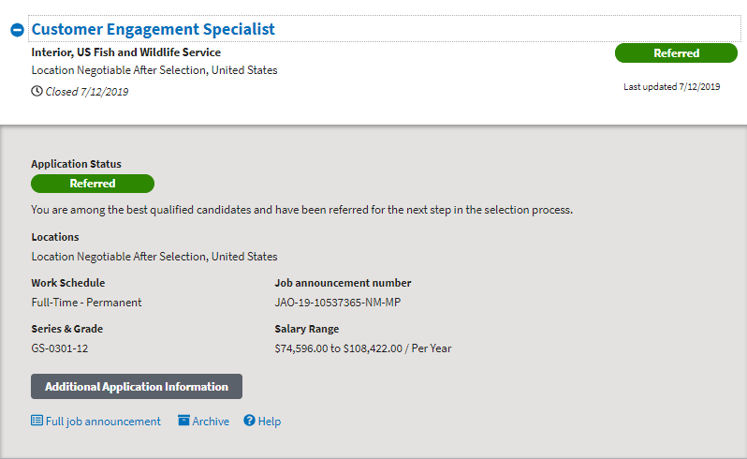
Understanding Your USAJobs Profile
Notes:
…you get more options and details about the vacancy. You’ll see your application status, which can be In Progress, Incomplete, Received, Referred, Not Referred, Canceled (vacancy withdrawn, no one was selected), Selected, Not Selected, Hired, or Not Hired. You can also view the full job announcement, which is helpful for if you are interviewed to remind yourself about all the duties and qualifications so you can speak to that.

Slide 6
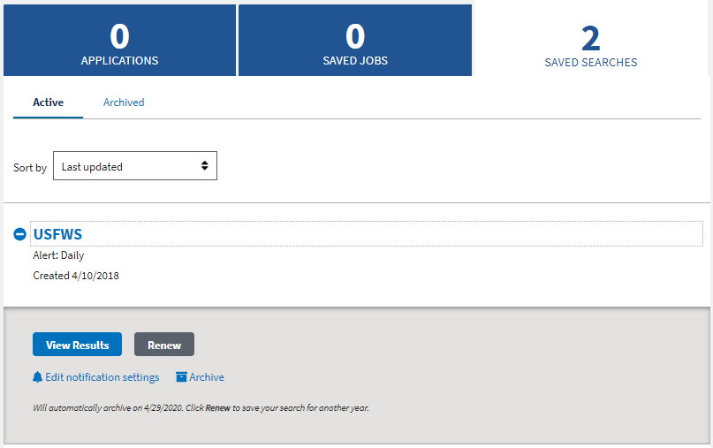
Understanding Your USAJobs Profile
Notes:
You can click the Saved Jobs tab if you have saved any positions, which you can do in a vacancy announcement during a job search. If you click on the Saved Searches tab, you’ll see your saved searches. You can expand it by clicking on the blue plus sign next to any saved search. You can delete the saved search, or change the frequency of notifications, or renew the saved search. Saved searches expire after 1 year.

Slide 7
Understanding Your USAJobs Profile
[Your Name]
Notes:
Back at the home screen, click on Profile at the top to complete your profile.

Slide 8
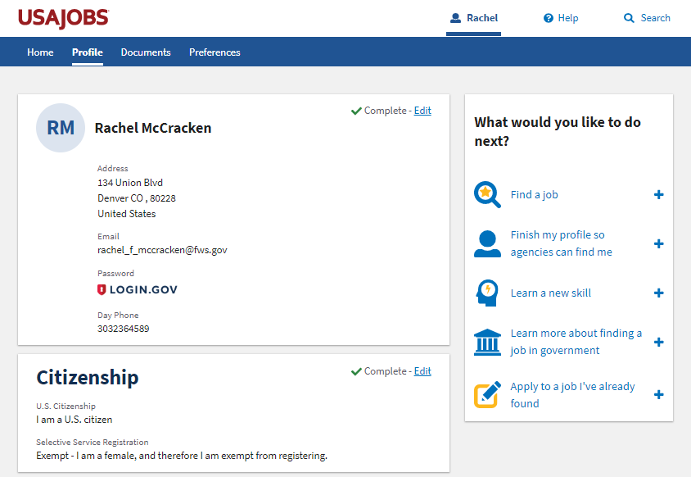
Understanding Your USAJobs Profile
Notes:
Some of the information you input on the Profile tab, Documents tab, and Preferences tab can be seen by agency recruiters and HR if you make your resume searchable, which I’ll show you on the Documents tab. Other information is used to make your application process faster so you can import this information to an agency’s application database without having to re-create it every time like citizenship, hiring paths, and some others. Note that you should update your resume every time you apply.

Slide 9
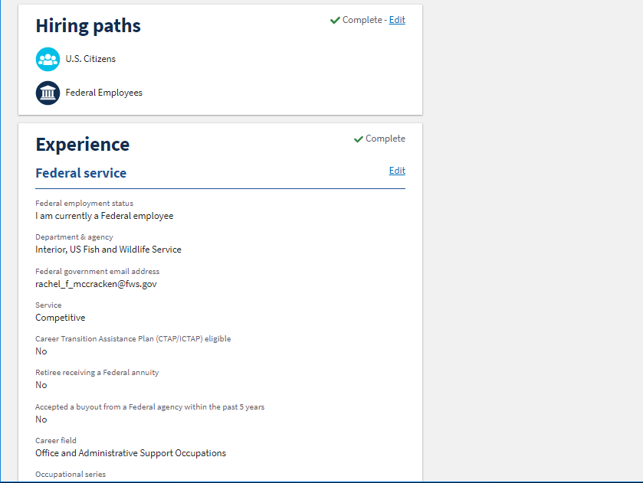
Understanding Your USAJobs Profile
Notes:
As you scroll down, the profile will ask you to fill in information based on how you answered “Hiring Paths” to verify your response. In this case, it asks about my federal experience.

Slide 10
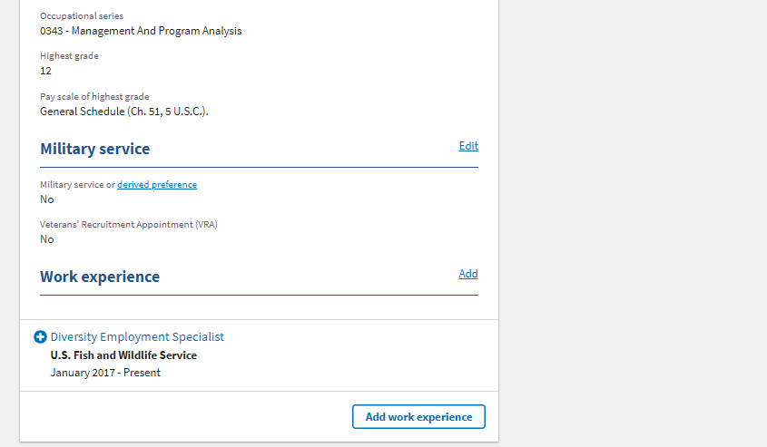
Understanding Your USAJobs Profile
Notes:
Lastly, at the bottom it asks about military service and work experience and, below this, about education, demographics, languages, and references. Regarding work experience, education, and references, I wouldn’t waste your time updating this information here in favor of making sure it’s up-to-date in the Documents section, which we’ll get to next. Lastly, I’ll point out the demographic data is collected to ensure that we as an agency are reaching diverse demographic groups and are hiring at a rate consistent with our application rates regarding demographics. This demographic information is NOT shared with hiring managers and is separated from your application so it is never paired with your application after you hit submit. The demographic information is voluntary.

Slide 11
Uploading vs. Building a Résumé in USAJobs
Uploading a Résumé
Building a Résumé using USAJobs
Other Documents
Notes:
So let’s switch gears to Documents…. This is where your resume(s) are stored.

Slide 12
Understanding Your USAJobs Documents
Notes:
If you click on the Documents tab, you will be able to view your resumes. Here, you can either upload a resume using Word or PDF or you can build one using the resume builder. You can have up to 5 different resumes in this section so, for example, if you wanted to have one tailored more to field work and one tailored more to management-related positions, you can create and save more than one. For your existing resumes, you can view, edit, delete, and duplicate the resume. You can also click *this* checkbox to make your resume searchable by agency recruiters and HR employees. Occasionally, we recruit using this tool (mainly for individuals who indicate they have a special hiring authority).

Slide 13
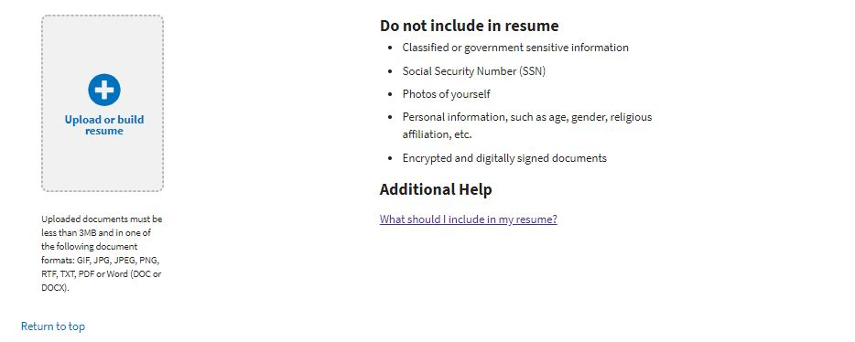
Understanding Your USAJobs Documents
Notes:
This icon will allow you to upload or build a resume using the resume builder. The output from resume builder is pretty ugly, so if you’re sensitive to having a fancifully-formatted resume, it would be better to upload a resume. Although the output of the resume builder isn’t “pretty,” hiring managers have all seen them before. Using the resume builder as a guide to at least make sure you are including all the required information is probably a good idea if you opt to design and upload your own resume.
So let’s take a look. I’m going to show you what it looks like to build a resume. If you upload a resume, it can look however you want and uploading it is easy.

Slide 14
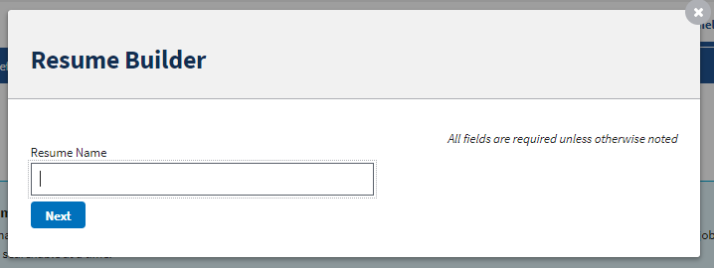
Understanding Your USAJobs Documents
Notes:
When you click Build Resume, you’ll give your resume a name. Like I mentioned, you can have up to 5 resumes saved, so you may want to give it a descriptive name like “Field Work Resume.”

Slide 15
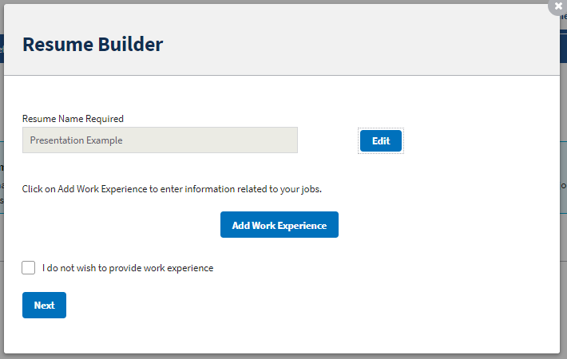
Understanding Your USAJobs Documents
Notes:
You are first given the option to add Work Experience, which is always a good idea on a resume. ☺

Slide 16
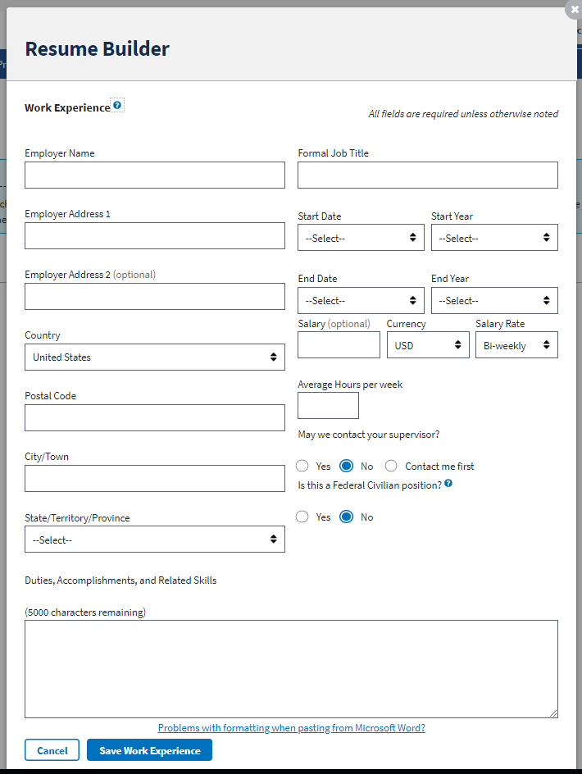
Resume builder work experience
Notes:
When you click “Add Work Experience,” you’ll see all the required and optional fields that you should complete for each experience (paid or not!). Some of the more unusual fields that you might not normally put on your resume include start and end months, salary (which for USFWS is required, not optional), average hours per week (also required for USFWS), and a supervisor reference for each position.
As you can see, the resume builder has a character limit in some sections like duties and accomplishments. If you upload your own resume rather than using this resume builder, you’re obviously not bound to that character limit.

Slide 17
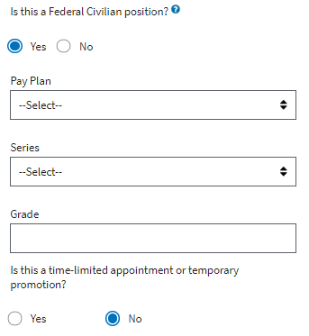
Resume builder work experience details
Notes:
If the work experience was a job with the federal government, you’ll click yes and then this section expands so you add details about the pay plan (most of the time GS), then job series and grade.
You can continue adding work experience for each position by saving and click “add work experience” on the previous screen. Remember, unpaid positions and internships also can be added here. When you are done adding all your work experience, you’ll click next and then can add all your education.

Slide 18
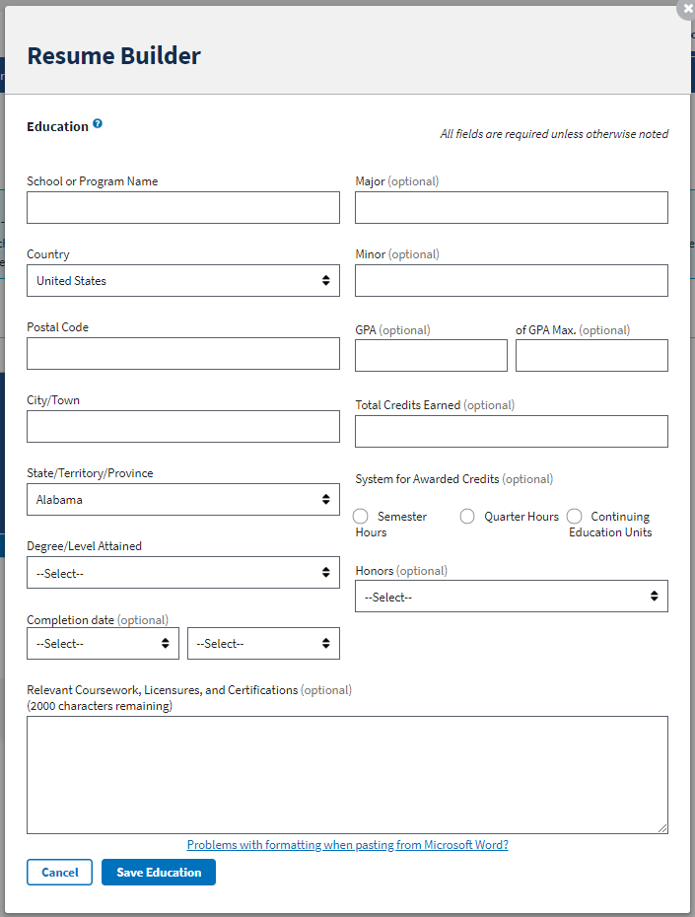
Resume builder education
Notes:
You’ll click “Add Education” on a similar screen for each level of education you’ve had (High School, Associate’s degree, Bachelor’s, Master’s, even if you only took a class here or other at the college level). Although you’ll need to attach your transcripts if you are qualifying based on education, you can use this relevant coursework section to expand upon particular experience you gained as part of your education. For example, if you had a field study class where you learned how to band, count, and collect data on waterfowl, you could list the course name and add this experience below.

Slide 19
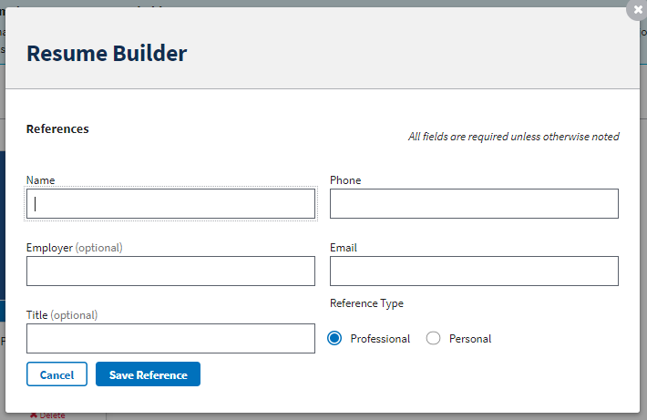
Understanding Your USAJobs Documents
Notes:
Next, you have the option to add references. These are in addition to, but can be the same as, the supervisors you listed in the Work Experience section.

Slide 20
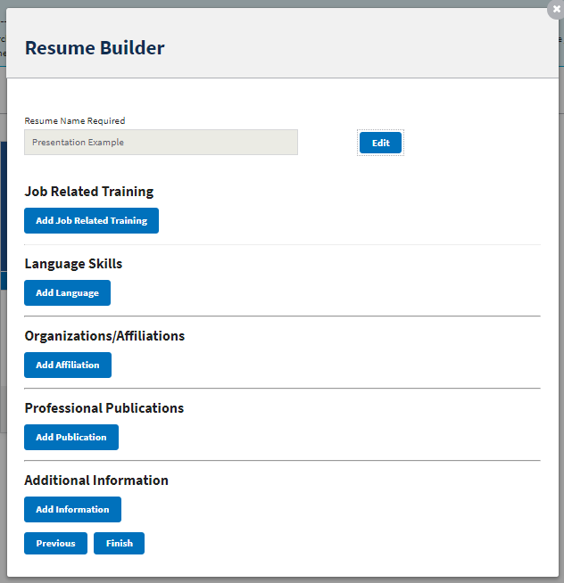
Resume builder additional information
Notes:
Lastly, you have the option of adding additional information like job-related training, languages, organizations or affiliations, Professional publications, and other information (like awards, for instance). All of these are optional.

Slide 21
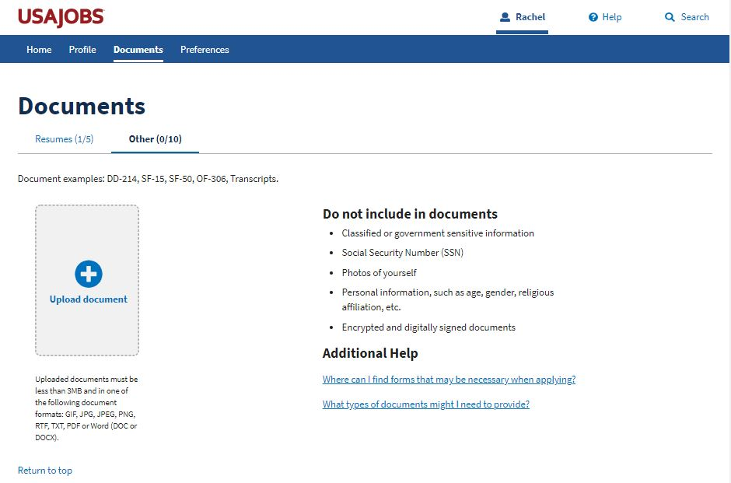
Understanding Your USAJobs Documents
Notes:
If you scroll back to the top, you can select “Other” to add other documents. This is where you can upload transcripts (required if you are qualifying based on education or there is a positive education requirement), SF-50 if you are a current or former federal employee, SF-15 and/or DD-214 if you are veteran claiming preference, a cover letter, etc. Cover letters are optional for USFWS, but I’ll talk about more it later.

Slide 22
Federal Résumé Tips
Differences in Federal Résumés vs. Traditional Résumés
Tailor your Résumé
General Résumé Considerations

Slide 23
Traditional versus federal resume
Brief. No more than 1-2 pages with highlights.
Objective, Skills, or Profile sections can be common.
Traditional Résumé
Requires salary, average hours per week, start and end month and year, job title, employer, and supervisor and their contact information (optional).
Extremely tailored to vacancy announcement and applicant questionnaire.
Should rely on competencies as a result of experience.
No page limit… but use good judgment.
Federal Résumé

Slide 24
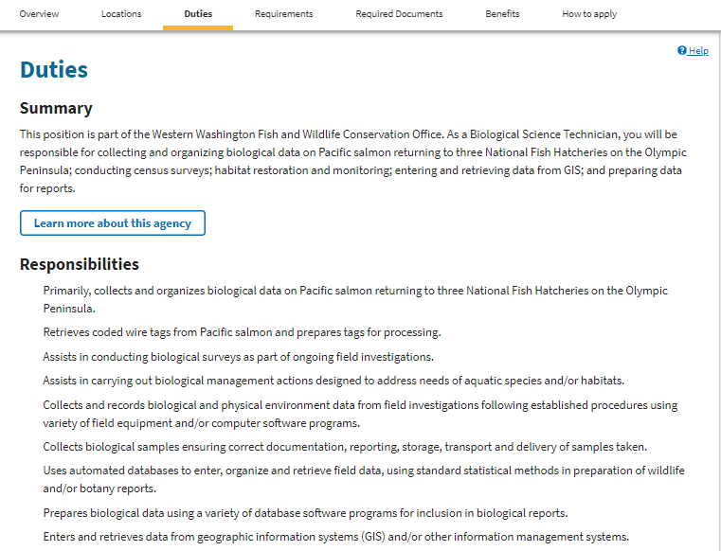
Tailoring Your Résumé
Include your experience related to the position. Here’s where you can look for clues on relevant experience:
Responsibilities
Qualifications (Specialized Experience)
How You Will Be Evaluated (Competencies, Knowledge, Skills, and Abilities)
Applicant Questionnaire (questions relate to knowledge, skills, and abilities listed in How You Will Be Evaluated)
Notes:
When applying for a federal position, tailoring your resume is critical since it serves as your application. It is thoroughly reviewed if you meet minimum qualifications to rank resumes in to quality categories (highest or best qualified, qualified, and not qualified). One of the first places in the JOA you can look for clues about what to include in your resume is the Responsibilities subsection under Duties. If you have had past experience with any of these responsibilities, it should be in your resume.

Slide 25
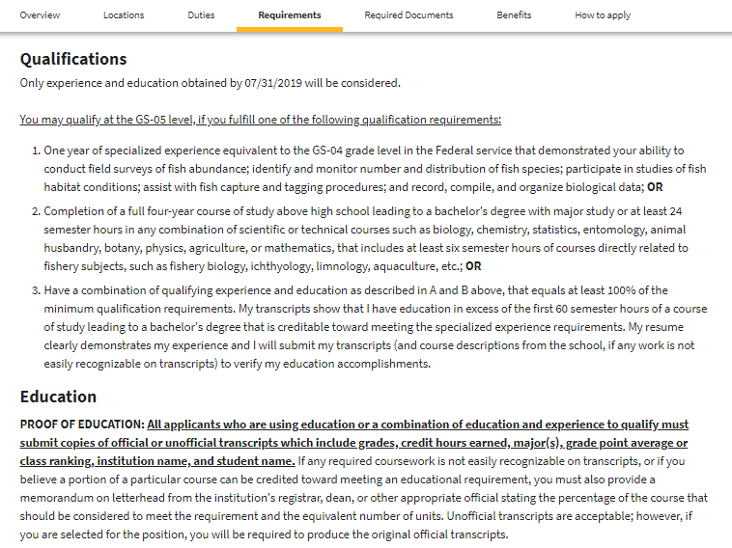
Tailoring Your Résumé
Include your experience related to the position. Here’s where you can look for clues on relevant experience:
Responsibilities
Qualifications (Specialized Experience)
How You Will Be Evaluated (Competencies, Knowledge, Skills, and Abilities)
Applicant Questionnaire (questions relate to knowledge, skills, and abilities listed in How You Will Be Evaluated)
Notes:
The next section you need to review to ensure you include this information in your resume is the Qualifications subsection under Requirements. Later in the applicant/occupational questionnaire you will identify how you are qualifying, which usually must be based on one of these categories: specialized experience, education, or a combination of the two. Education is easy to prove—you will include your transcripts in your application. Specialized experience must be proven in your resume by listing this experience.

Slide 26
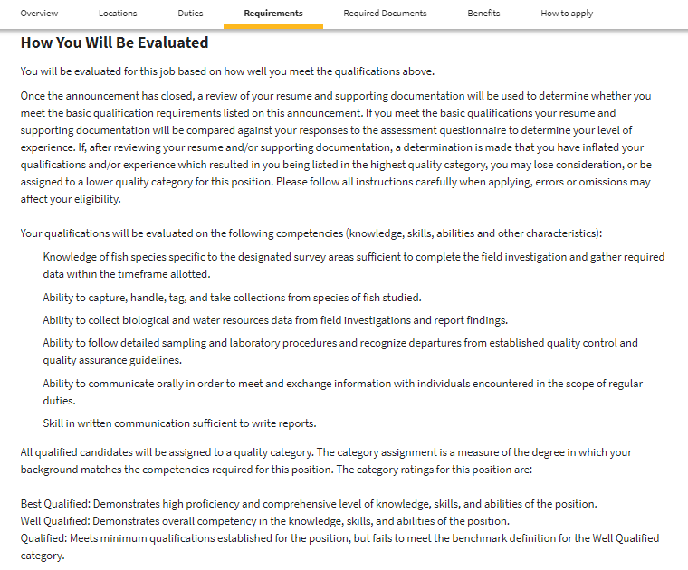
Tailoring Your Résumé
Include your experience related to the position. Here’s where you can look for clues on relevant experience:
Responsibilities
Qualifications (Specialized Experience)
How You Will Be Evaluated (Competencies, Knowledge, Skills, and Abilities)
Applicant Questionnaire (questions relate to knowledge, skills, and abilities listed in How You Will Be Evaluated)
Notes:
In the How You Will Be Evaluated subsection, you will find a list of competencies (knowledge, skills, and abilities) that are guidelines against which your resume will be evaluated to rank you into one of the quality categories. These competencies are further expanded in the questionnaire.

Slide 27
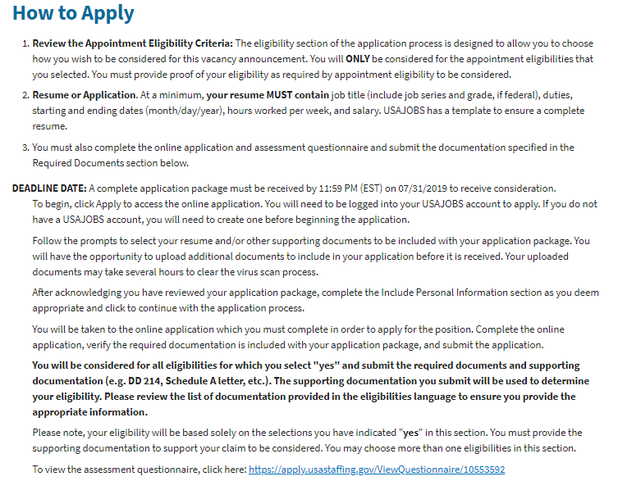
Tailoring Your Résumé
Include your experience related to the position. Here’s where you can look for clues on relevant experience:
Responsibilities
Qualifications (Specialized Experience)
How You Will Be Evaluated (Competencies, Knowledge, Skills, and Abilities)
Applicant Questionnaire (questions relate to knowledge, skills, and abilities listed in How You Will Be Evaluated)
Notes:
You can find a link to questionnaire in the JOA. Usually it’s in the How to Apply section at the bottom (you have to expand the section to see it).

Slide 28
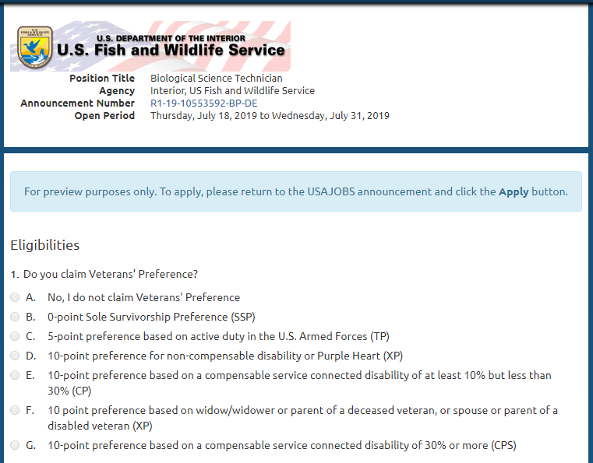
Tailoring Your Résumé
Include your experience related to the position. Here’s where you can look for clues on relevant experience:
Responsibilities
Qualifications (Specialized Experience)
How You Will Be Evaluated (Competencies, Knowledge, Skills, and Abilities)
Applicant Questionnaire (questions relate to knowledge, skills, and abilities listed in How You Will Be Evaluated)
Notes:
This is what the questionnaire looks like when you click it. Usually the first several questions as if you are applying with veterans preference and ask you to identify how you are qualifying (specialized experience, education, or a combination of the two).

Slide 29
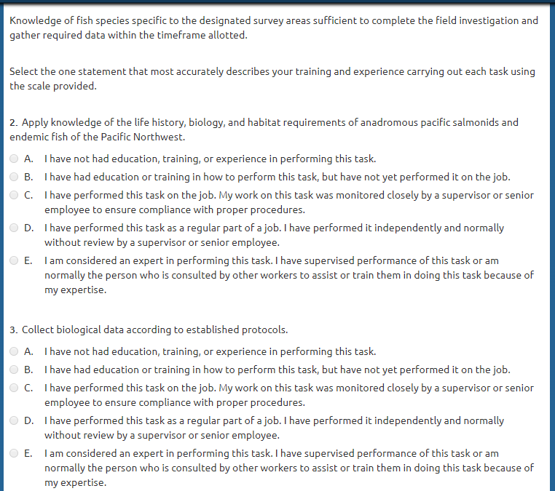
Tailoring Your Résumé
Include your experience related to the position. Here’s where you can look for clues on relevant experience:
Responsibilities
Qualifications (Specialized Experience)
How You Will Be Evaluated (Competencies, Knowledge, Skills, and Abilities)
Applicant Questionnaire (questions relate to knowledge, skills, and abilities listed in How You Will Be Evaluated)
Notes:
After the initial logistical questions, you’ll scroll down to find the competencies listed in the How You Will Be Evaluated section (in this picture it’s the “Knowledge of fish species specific to the designated survey areas…”). Questions 2 and 3 drill down deeper into what your knowledge of fish species is. If you rank yourself as having any degree of experience or knowledge in these questions, that must be demonstrated on your resume. So if you rate yourself as a “B. I have had education or training in how to perform this task, but have not yet performed it on the job,” then somewhere under education, this skill needs to be listed. You can attribute it to a course you took in the same manner you would have a bullet point under a work experience listing this as duties.
Tailoring your experience to these questions is especially critical. If you rank yourself has having a high degree of experience in this questionnaire, but your resume doesn’t obviously reflect this experience, Human Resources downgrades your score and you could be reduced to a lower quality category (like from highest qualified to qualified).

Slide 30
General Résumé Considerations
Cover Letters
Volunteer Experience
Wordsmithing (assisting vs. teamwork)
Use the Active Voice
Human Resources vs. Hiring Managers
No Personal Information
Acronyms
Proofread
Apply early
Notes:
1. As I mentioned, cover letters are optional, however, I would encourage you to include one. Hiring managers have their own preferences and it’s impossible to know whether you’ll wind up with a hiring manager who, based on their personal preferences and values, will not consider any information in a cover letter versus one who won’t consider a candidate who doesn’t include one. It’s best to err on the side of caution. That said, don’t include any qualifications in your cover letter that aren’t in your resume. Human Resources will probably not review or consider this information. Cover letters are a good place to say what the position and mission of the agency mean to you, why you think you are best suited for the position, whether a move to a new location where the position is located excites you if you are willing to relocate, etc.
2. When writing your resume, include ALL your experience, whether it was paid or unpaid. Internships, volunteering, representation as part of an organization’s board, etc. all count as experience. You can format this experience the same as you would work experience including start and end dates, title (e.g. volunteer, intern, board member), average hours per week, list salary as unpaid, and duties.
3. In federal resumes, wordsmithing counts. Using words like “assisted with …” can downplay or diminish your experience, whereas “supervised employees working on …” shows leadership. For example, one way you could change “Assisted a graduate student with field data collection” could be “Collected field data as part of a team contributing to graduate research on …”
4. You’ve probably heard about using the active voice… in middle school. As a reminder, the active voice is using action verbs rather than passive ones (like “Was the supervisor for # employees” instead of “Supervised # of employees.” You can google “active verbs for resumes” for help.
5. The process for federal hiring has 2 parts. The first person to see and review your resume will be a Human Resources professional. Their job is to review your resume to make sure you meet the requirements or qualifications and then to validate that your answers to the applicant questionnaire are found in your resume. So, it does no good to submit a generic resume and then answer that you are an expert in all the competencies asked about in the questionnaire if your resume does not support those responses. Human Resources ranks resumes that meet minimum qualifications based on applicant’s responses to the questionnaire from highest or best qualified, qualified, or not qualified. Only the top tier gets referred to the hiring manager. What a hiring manager is looking for in a resume is different from what Human Resources needs to see in a resume to rank a candidate highly. And, as I said, hiring managers are different in their preferences and values about what a resume should look like or include. However, I can nearly guarantee that no hiring manager wants to review a 20 page resume, so being as detailed as you can to meet the needs of the Human Resources professional, but as concise as possible to suit a hiring managers preferences is a good idea.
6. Your resume should not include personal information like SSNs or pictures. This information will be removed if it is included.
7. For resumes, federal or otherwise, do not use acronyms unless you first spell out their meaning. This goes for even internal applicants and is a general rule of thumb for all business correspondence.
8. Make sure you proofread or ask a friend or relative to proofread. Spell and grammar checks do not catch everything.
9. Lastly, make sure you apply as early as you can. Some vacancies are posted with an end date, but also indicate that they may close after a certain number of applications are received. Sometimes computers die, internet fails, USAJobs fails or goes down for maintenance, or any number of mishaps. Don’t wait until the last minute.

Slide 31
Thank You!
Contact:
Rachel McCracken
rachel_f_mccracken@fws.gov
303-236-4589

